Slide 1

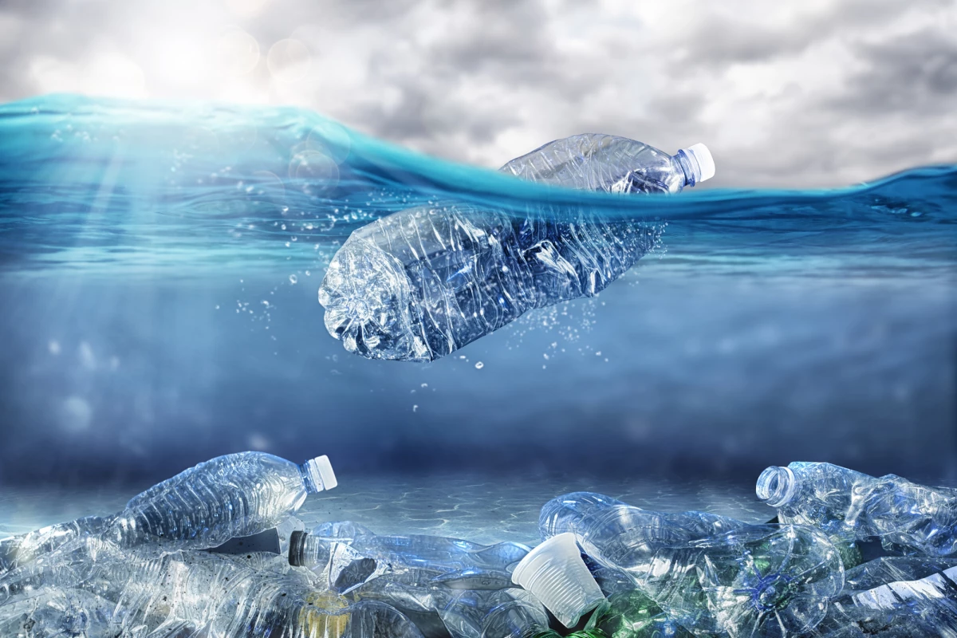
Predicting Microplastic Concentration in Ocean Waters Using Environmental, Spatial, and Sampling-Related Features
A Machine Learning and Visual Analytics Approach
MSc Business Analytics (2025-2026)
Abhinav Tyagi
Student ID: 20028460
Supervisor:
Dr Sajal Kaur Minhas

Slide 2
Background AND motivation
Rapid Growth In Global Plastic Production And Mismanaged Waste
Microplastics (<5 Mm) Detected Across All Ocean Basins
Severe Ecological And Potential Human Health Risks
Predicting Spatial Variability Remains Challenging Due To:
Complex Ocean Dynamics
Anthropogenic Influences
Sampling Heterogeneity
Motivation: To Explore Whether Machine Learning Can Provide Scalable, Predictive Insight Into Global Microplastic Concentration Patterns

Slide 3
Research problem and Objectives
Research Problem
Existing Models Are Either:
Region-specific
Computationally Intensive
Not Easily Scalable
Objectives
Integrate Global Microplastic, Oceanographic, And Anthropogenic Datasets
Develop And Compare Multiple ML Regression Models
Identify Key Environmental And Human Drivers
Evaluate Predictive Performance And Generalisability

Slide 4
Reference Research Study
Referred Study Overview
Objective:
Detect And Classify Marine Plastic Waste
Methods:
Two-step Clustering
Fully Convolutional Neural Network (FCN)
Dataset: Kaggle Plastic Location Data
Reported Accuracy: 98.38%
Key Difference from This Study
Aspect | Reference Study | This Dissertation
Task | Classification | Regression
Scope | Local / system-based | Global
Data | Image & location data | Environmental + sampling
Metric | Accuracy | R², RMSE, MAE

Slide 5
Data Sources and Data integration
Microplastic Observations
Oceanographic Data
Anthropogenic Data
Microplastic measurement
Sampling method
Mesh size
Date (Year, Month)
Latitude & Longitude
Machine Learning Pipeline
Random Forest
Gradient Boosting
SVR
Neural Network
XGBoost
Data Preprocessing & Feature Engineering
Missing value handling
Encoding (categorical features)
Scaling (numerical features)
Train–test split
Ocean current speed
Sea surface temperature
Salinity
Population density
Figure: Integration of multi-source environmental, spatial, and anthropogenic datasets into a unified machine learning pipeline.

Slide 6
Feature engineering & preprocessing
Spatial Features: Latitude, Longitude, Region, Ocean
Temporal Features: Year, Month
Environmental Features: Current Speed, Temperature, Salinity
Anthropogenic Features: Population Density
Sampling-related Features:
Sampling Method
Mesh Size
Marine Setting
Techniques Applied
One-hot Encoding (Categorical Variables)
Standard Scaling (Numerical Variables)
Log Transformation Of Target Variable (Np.Log1p)

Slide 7
Model Evaluation Metrics
Models Evaluated Using:
R² (Primary Metric) – Variance Explained
RMSE – Prediction Error Magnitude
MAE – Robustness To Outliers
Validation Approach
80:20 Train–test Split
Cross-validation During Tuning
Unseen Test Set For Final Reporting

Slide 8
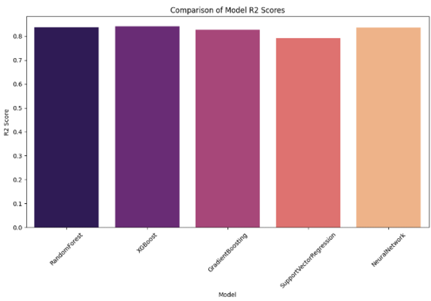
Machine Learning Models AND Performance
Random Forest
Gradient Boosting
Support Vector Regression
Neural Network
XGBoost
Why Multiple Models?
To assess robustness
To avoid algorithm-specific bias
To identify best-performing approach

Slide 9
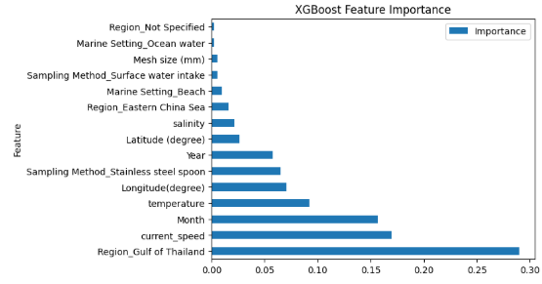
Feature importance analysis
Feature importance plot
Top features:
Region
Ocean current speed
Month
Temperature
Sampling method

Slide 10
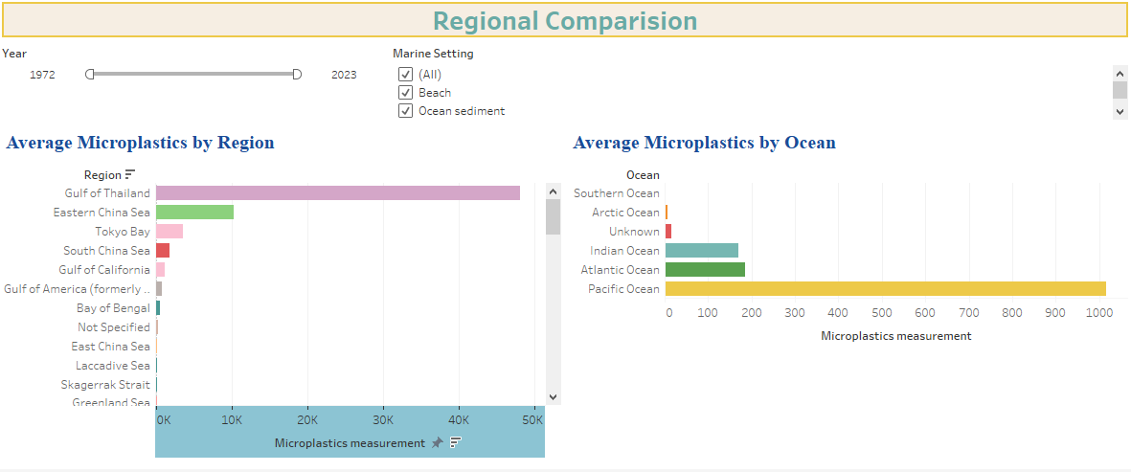
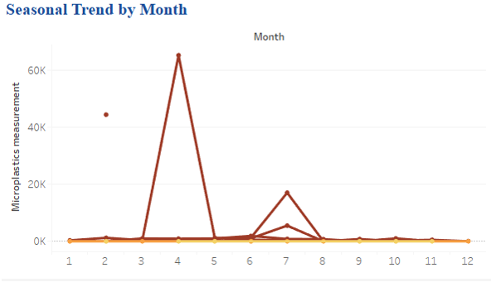
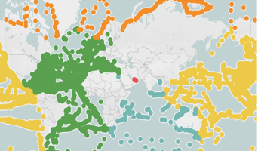
Exploratory Data Analysis
Global spatial distribution map
Regional comparison dashboard
Temporal trend analysis

Slide 11
Conclusion & contributions
Key Conclusions
Machine Learning Can Effectively Model Global Microplastic Concentration
Xgboost Outperforms Other Models In Accuracy And Stability
Environmental And Regional Drivers Dominate Predictions
Sampling Variability Significantly Affects Observed Concentrations
Contributions
Global-scale Predictive Framework
Integration Of Environmental + Anthropogenic + Sampling Data
Strong Empirical Support For Data-driven Marine Pollution Modelling

Slide 12
Limitations and future work
Limitations
Static Environmental Representation
Sampling Bias In Observational Data
No Explicit Particle Drift Trajectories
Future Directions
Time-resolved Oceanographic Coupling
Integration With Physical Drift Models
Inclusion Of River Discharge And Waste Management Indicators
Spatio-temporal Deep Learning Models

Slide 13
THANK YOU
Questions & Answers (Q&A)

